Slide 1


Concisea(Bitly Clone)
CHANDAN CHOUDHURY | CL2025010601911046 | 2201020352
ADITYA NAYAK | CL2025010601911349 | 2201020377
SANJEEB KUMAR POTHAL | CL2025010601938185 | 2201020411
GYANA RANJAN SAHOO | CL2025010601938118 | 2201020033

Slide 2



CONTENT
Introduction
Database Design
Problem Statement
Website Overview
Proposed Solution
Key Functionalities
Technologies Used
Future Enhancements
System Architecture
Conclusion

Slide 3


Introduction
Our project, URL Shortening System (Bitly Clone), is a web-based application designed to simplify and manage URLs efficiently. It allows users to convert long URLs into concise links using unique shortcodes. The system also includes an Admin Panel for tracking clicks, managing URLs, and analyzing link performance.

Slide 4

Problem Statement
Lengthy URLs are difficult to remember and prone to errors.
Sharing long URLs in social media posts, SMS, or printed materials is inconvenient.
Users often face challenges in tracking URL performance and monitoring visitor engagement.
Managing multiple URLs efficiently is time-consuming without proper tools.

Slide 5



Proposed Solution
Our URL Shortening System (Bitly Clone) effectively addresses the identified problems by offering:
URL Shortening
Admin Panel
Database Integration
Redirection System

Slide 6









Technologies Used
Our project leverages the following technologies for efficient development and performance:
Frontend
Backend
Database
Build Tool
ReactJS
Java 23
Maven
PostgreSQL
CSS
Spring Boot

Slide 7
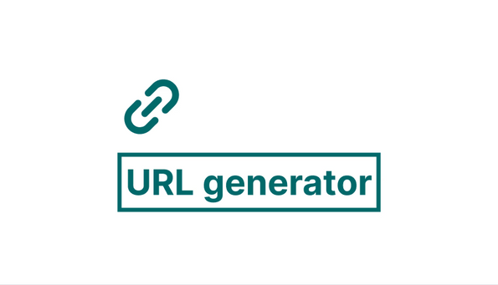
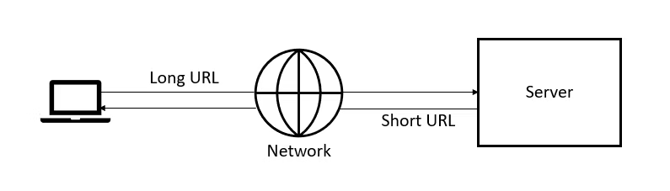

System Architecture
User Input: Users submit a long URL.
URL Generation: Generates a unique shortcode.
Database Storage: Original URL , Shortened URL & Click Count.
Redirection Process: Maps short URL to the original URL.
Click Tracking: Timestamp, and clicks.
Admin Panel: Manages URLs and tracks performance.

Slide 8
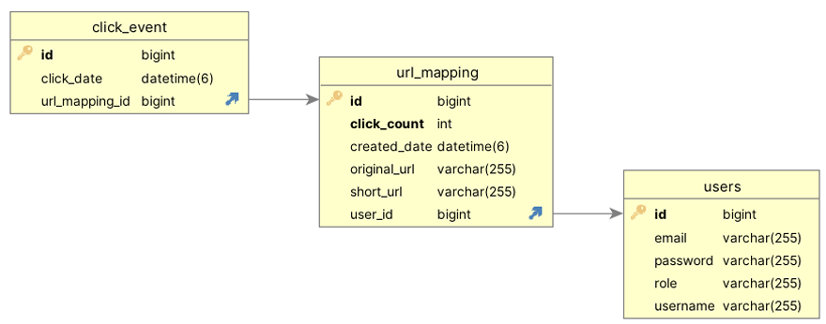

Database Design

Slide 9
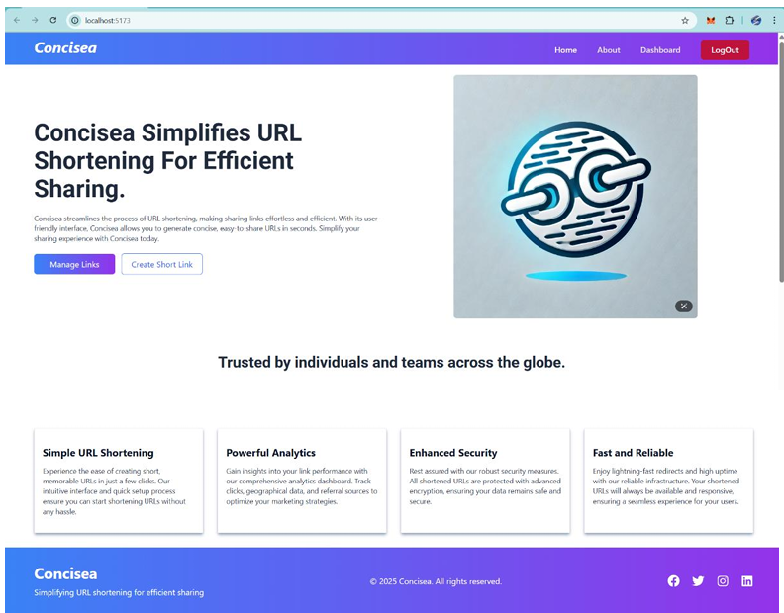
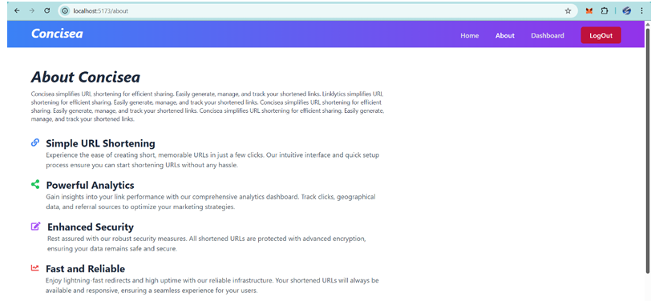
Website Overview
Home Page
About page

Slide 10
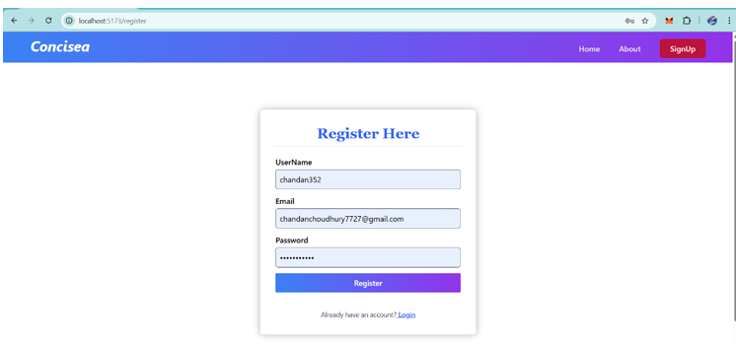

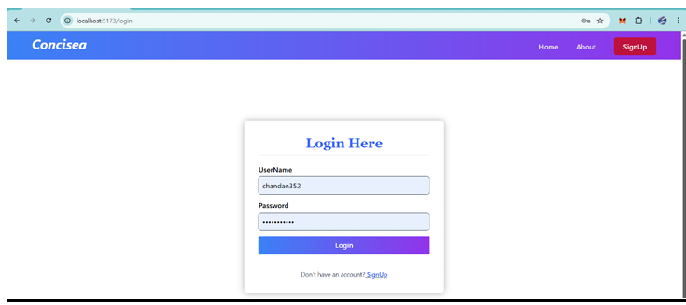

Signup page
Login page

Slide 11

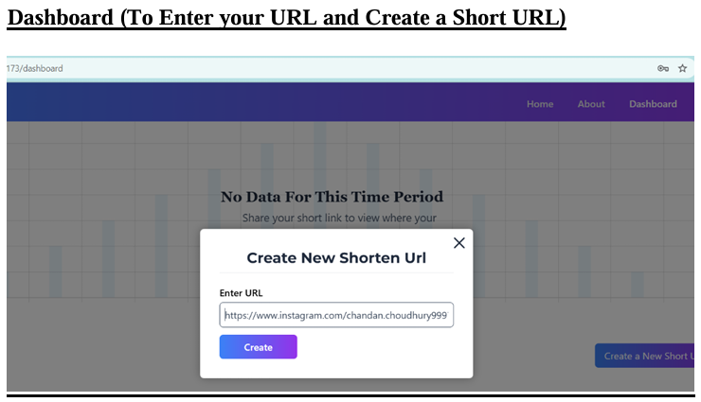
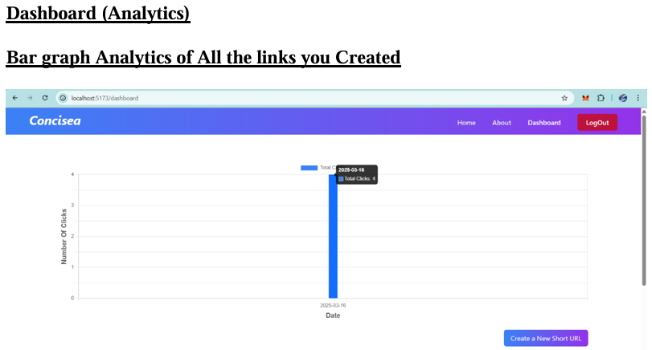
Dashboard (To Enter your URL and Create a Short URL)
Dashboard (Analytics) Bar graph Analytics of All the links you Created

Slide 12

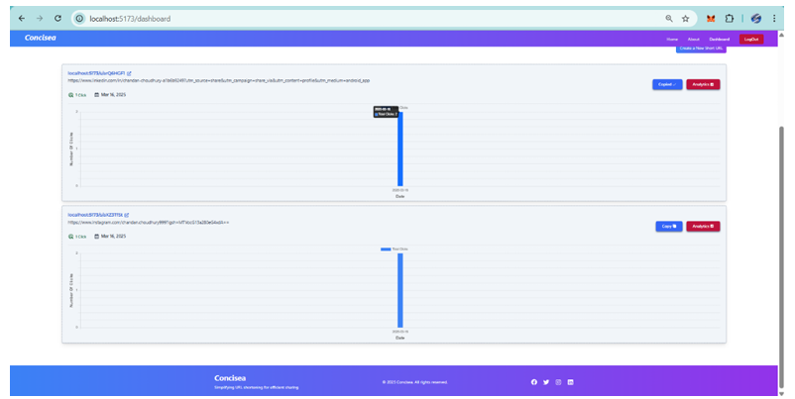

Individual Analytics of the links you created

Slide 13

Key Functionalities
URL Shortening: Converts long URLs into short, unique links.
Redirection System: Ensures accurate mapping of short URLs to original links.
Click Tracking: Stores timestamps and click counts.
Dashboard: Manages URLs, tracks analytics, and provides insights.
Error Handling: Displays meaningful error messages for invalid or expired URLs.

Slide 14



Future Enhancements
QR Code Generation: Provide QR codes for shortened URLs.
Custom Short URLs: Allow users to create personalized short links.
Enhanced Analytics: Add detailed insights like geographic data and device info.
Link Expiry Feature: Enable users to set expiration dates for links.
Improved Security: Implement features like CAPTCHA to prevent bot abuse.

Slide 15







Conclusion
Developed a powerful and efficient URL Shortening System.
Enhanced user experience with fast redirection and detailed tracking.
Integrated a robust Admin Panel for seamless URL management.
Strengthened technical skills in Java 23, Spring Boot, and MySQL.
Our solution offers a scalable, secure, and user-friendly platform for managing URLs effectively.

Slide 16


